Slide 1

Welcome to the future of business improvement
Notes:
Our vision is to be the business improvement company that enables organizations to turn standards of best practice into habits of excellence.
By convening committees of world-leading industry experts, we gain consensus on the latest definitions in industry best practice and help organizations to embed them in their processes and procedures
The result is that BSI’s positive influence on organizational performance extends to mainstream industry advancement on a widespread and global scale.

Slide 2



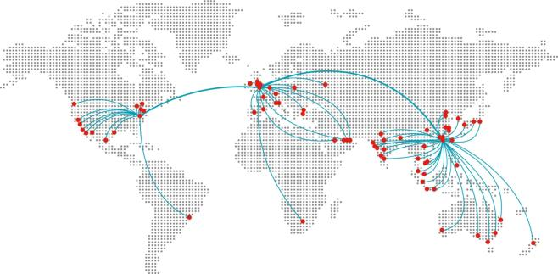
BSI is truly a global brand
BSI clients represent
90 offices with 4,500 colleagues
and 12,000 experts
92,000
clients in
195
countries
81%
of Nikkei 225 Index
50%
of Fortune 500
84%
of FTSE 100
15,000+ active product certifications
3,100
new standards per year 90,000*
in all
232,000
audit days
delivered last 12 months
212,000
delegates
trained last 12 months
63,500
consulting days
delivered last 12 months
+£500m
revenue
* Number of standards available on BSOL
Notes:
BSI Offices are located in: Australia, Austria, Belgium, Brazil, Canada, Chile, China, Colombia, Costa Rica, Czech Republic, France, Germany, Hong Kong, Iceland, India, Indonesia, Ireland, Israel, Italy, Japan, Korea, Malaysia, Mexico, Mongolia, Netherlands, New Zealand, Peru, Philippines, Poland, Russia, Singapore, South Africa, Spain, Sweden, Switzerland, Taiwan, Thailand, Turkey, United Arab Emirates, United Kingdom, United States, Vietnam

Slide 3








BSI entered Indonesia for certification body and training academy
Sir John Wolfe-Barry founded BSI（designer of London Tower Bridge）
BSI Kitemark® released the first national standard
BSI is a founding member of the International Organization for Standardization (ISO) and has permanent seats
Released BS 5750 – Convert to the widely used ISO 9001 quality management system standard
Acquiring Neville Clark Training & Consultant
1901
1903
1929
1946
1964
1979
1992
2003
2012
2018
2021
The first national standard oranization in the world
Acquireed Royal Charter
Founding member of the European Committee for Standardization (CEN) with permanent board seats
Released BS 7750, the world's first environmental management system, which was transformed into ISO 14001
2003-2021, selected as a global super brand by internationally recognized brand ruling organizations for 18 consecutive years
Copyright © 2019 BSI HKU. All rights reserved

Slide 4
We SHAPED the top 10 Business Standards used worldwide
Year | Management System | British Standards | Adopted by ISO
1979 | Quality Management | BS 5750 | ISO 9001
1992 | Environmental Management | BS 7750 | ISO 14001
1995 | Information Security | BS 7799 | ISO/IEC 27001
1996 | Occupational Health & Safety | BS 8800 | ISO 45001
2000 | Customer Satisfaction | BS 8600 | ISO 10002
2002 | IT Service Management | BS 15000 | ISO/IEC 20000-1
2006 | Integrated Management | PAS 99
2007 | Business Continuity Management | PAS 56 | ISO 22301
2008 | Asset Management System | PAS 55 | ISO 55001
2009 | Energy Management | BS EN 16001 | ISO 50001
2011 | Anti-Bribery Management | BS 10500 | ISO 37001
2013 | Information management using BIM | PAS 1192 10500 | ISO 19650
Notes:
This is a chart of the Top 10 Standards in the world, most started as British Standards and two started as PAS Standards which are PAS 99 Integrated Management and PAS 56 Business Continuity Management.
A PAS standard can become a British Standard which can become an ISO standard

Slide 5






BSI - end-to-end solutions
Assurance
Assess
Assess clients processes, procedures and products
227,000 audit days
delivered
13,000 active product certifications
Shape
Share
Embed
Continually improve
Ensure continual improvement in people processes and products
86,000
organizations choose to work with BSI every year
Collaborate to develop best practice
2,700
new areas of best practice published annually
Share knowledge and best practice guidance
90,000 areas of best practice to choose with text analytics
Help clients embed best practice
150,000
delegates
trained annually
Advise
Advise clients – EHS, Cyber and Supply Chain
Professional
Services
Notes:
As part of our aim to be the global business improvement partner of choice BSI has an end-to-end range of solutions which are designed to help organizations embed best practice and continually improve. Very few others do this, and none have been doing it as long as we have.
It starts with standards creation where we bring industry experts together to shape collective best practice. Currently there are over 34,000 of them within our portfolio.
To ensure best practice is shared, we publish standards in innovative ways, such as through our online database BSOL. This provides cost-effective access to the latest versions of standards and contains a library of over 90,000 internationally recognized standards. (Healthcare may want to give the example of Compliance Navigator)
And then to help embed best practice in organizations the BSI Training academy offers in-company, public, or online learning to ensure that your people have the right knowledge to apply the skills they have learned when they return to your organization.
Every year our independent and impartial expert assessors carry out thousands of days of assessment in sites all over the world to help organizations
perform at a high level and demonstrate to customers, competitors, suppliers, staff and investors that they are committed to continuous improvement and making compliance to a standard an ongoing habit. Our software tools can help automate this processes.
And finally, if you’d like BSI to simply tell you what you need to do and how to do it instead of certification, we can provide professional services across a number of disciplines to ensure you are compliant and taking full advantage of best practice.

Slide 6
















BSI Global Clients

Slide 7






















BSI Indonesia Clients

Slide 8

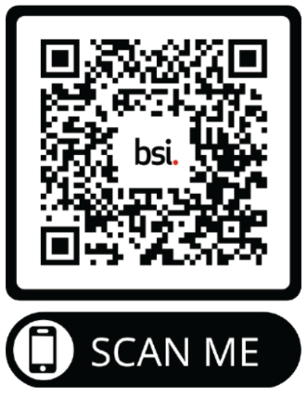
Jakarta - Head Office
Talavera Office Suite 20th Floor
Jl. TB Simatupang Kav 22-28
Cilandak, Jakarta 12430
Phone: +6221 80649 600
Email: info.indonesia@bsigroup.com
Website: bsigroup.com/en-ID
Connect with BSI on social media
Surabaya Office
Graha Pena Building 8th Floor,
Suite 803, Jl. Ahmad Yani 88,
Surabaya 60234
Phone: +62 31 820 2029
Sumatera Office
My Office, Graha Edukasi Lantai 3,
Jl. MP Mangkunegara No.05
Bukit Sangkal, Kalidoni, Palembang,
Sumatera Selatan 30119
Phone: 0711 5704 799

Slide 9

BIM – Asset Information Management (AIM) Operation & Maintenance
BIM– as a Sustainability Way
Sugeng Riyadi
Built Environment Sector Manager
Sustainability Champion
British Standards Institution - Indonesia
July 29, 2023

Slide 10
1. BIM – Asset Information Management

Slide 11
What is BIM?
BIM
Information management
Collaborative working
Whole lifecycle
Notes:
BIM consists of a series of individual discipline models, documentation and data and is a process by which all of the information is gathered to provide more value added solutions for the client at handover stage.
The diagram above indicates how BIM is tied together by digital information but the processes, procedures and people must be put in place to ensure the process runs as smoothly as possible. This process involves a series of individual discipline models that come together to form a ‘federated’ model for coordination and use.
BIM is defined as a process rather than an object. The process must be understood by all parties involved on a project. It is extremely important that the BIM strategy of the project is known by all those involved in order for each party to achieve the relevant return on investing in this process.
Further in the course we will explain how the processes, procedures and people are critical to the success of a BIM project, but in order to understand why it is relevant to discuss what BIM entails and then dissect how it positively affects our work.
In the UK alone, there are close to three million people who work in construction and therefore to upskill this number of individuals is a significant task for our industry. To be able to implement BIM for your company it may be necessary to influence key personnel to ensure they have the relevant drive to be able to push the implementation process across others. You can then feed this knowledge to your supply chain in order to support the process of training and managing BIM.
Depending on the size or nature of the company you work for, it may be necessary to ensure that these individuals act as the BIM advocates, promoting and working towards the goal for the growth and profitability of the company. Critical drivers for BIM are the ‘enablers’ and these people will ensure they share, support and provide guidance in regard to your company and projects.

Slide 12
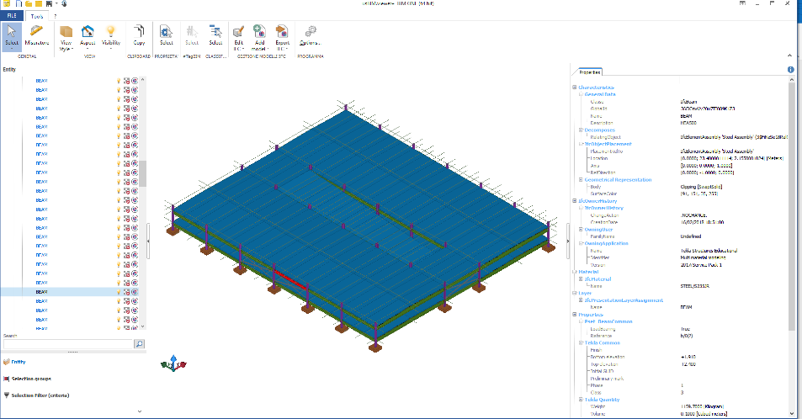
Modelling fundamental (information model) – geometry, data and documentation
Class
Assembly
Position
Shape
Material
Name
Loadbearing
Quantity
Notes:
An information model may contain:
Physical entities documenting the building/facility*, systems, product types and instances
Spatial entities documenting the site, zones, storeys/regions*, spaces/locations*
Process entities documenting the project, and for 4D work-packages, job types and tasks
All of these can be located and related together, so it is not just a list. For example an instance may have:
A class/family such as IfcBeam
A name ‘BEAM’ and a description ‘HEA500’ (disappointing)
A unique identifier ‘36CICswVv20u7TI089K123’
A 3D shape (highlighted in red)
Other shapes such as plan symbols (not shown)
Measured quantities such as 0.1 m3 and 1159 kg
Attributes and properties such as ‘Loadbearing’ TRUE
Associated material STEEL/S235JR, classification and documentation
Relationship to their named assembly ‘Steel Assembly’
(or a Relationship to a named storey/region*, space/location*
Relationship to their system (group or collection)
Relationship to their product type ‘HEA500’ (not shown)
Relationship to design, construction or in-use tasks
Terminology may vary especially between building/infrastructure.
Information on scheduling (4D), cost (5D), Sustainaibility (6D), and operation and maintenance (O&M) (7D)

Slide 13
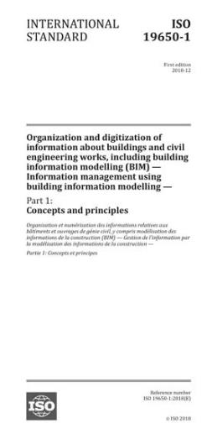
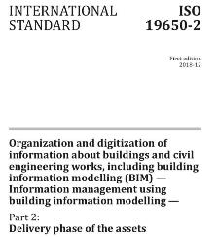
ISO 19650-2:2018
Implementing BIM on a project (delivery phase of an asset)
Activities to set up project-wide information management by client (appointing party)
Organization and digitization of information about buildings and civil engineering works, including building information modelling (BIM) – Information management using building information modelling –
Part 2:
Delivery phase of the assets
Activities to make an appointment (tender invitation and response)
Activities to prepare for information production (delivery team planning and mobilization)
Activities to produce information (delivery team and task teams)
UK National Annex to implement national standard for container naming and metadata
Notes:
ISO 19650 Part 2 applies the principles in Part 1 to the delivery phase.
Clauses 1, 2, 3 – scope, normative references and terms and definitions
Clauses 4 and 5 define the Information management process
Clause 5.1 Assessment and need
Clause 5.2 Invitation to tender
Clause 5.3 Tender response
Clause 5.4 Appointment
Clause 5.5 Mobilization
Clause 5.6 Collaborative production of information
Clause 5.7 Information model delivery
Clause 5.8 Project close out
Annex A Information management assignment matrix (informative)

Slide 14
ISO 19650-3:2020
Requirements for information management during operational phase
Covers different routes for acquiring information
Organization and digitization of information about buildings and civil engineering works, including building information modelling (BIM) – Information management using building information modelling –
Part 3:
Operational phase of the assets
Owner/operator sets Organizational, Asset and Exchange Information Requirements
Creation and maintenance of the Asset Information Model (AIM)
Applies to external contracts and in- house appointments
Aligns with ISO 55000 series (asset management)
Notes:
ISO 19650 Part 3 applies the concepts and principles from ISO 19650 Part 1 to the operational part of the asset lifecycle, when the building or infrastructure is in use. There are many parallels between Parts 2 and 3, including the 8-step information management process.
The ISO 19650 terminology is also used, including the appointing party for the asset owner or operator, lead appointed party for the lead organisation in each delivery team, and appointed party for the lower-level appointments.
The appointment, mobilisation and information production requirements apply to any information provider, irrespective of whether this is an external contract or an in-house team, and also to any size of work in the operational phase (from small maintenance tasks up to major refurbishments). If necessary, the requirements of ISO 19650 Part 2 can be applied.

Slide 15
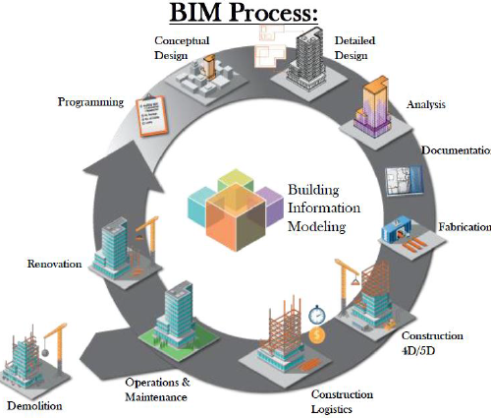
Construction Digitization
Asset Life Cycle
Industry 4.0
Source: George Brown College April 2016
Notes:
BIM offers enormous gains in savings in cost and time, a much greater accuracy in estimation, and the avoidance of error, alterations and rework due to information loss. Adopting BIM involves much more than simply training your staff in the necessary software skills. To achieve all the benefits it offers, all of those involved in the building, construction and operation of assets will need to learn to work in fundamentally new ways.
The way we work has changed (and will continue to do so) and we need to address what this means to our companies and wider industry as a whole. It is not only about training staff in technical skills, but also in how we effectively manage and share information across our projects in more effective ways. This will positively affect the projects you work on as well as the supply chain and relationships you have with other parties involved.
BIM also offers a way of working in a virtual environment using intelligent objects in a model so that design, construction, operation and sustainability can be tested and optimized before work commences on site. We should be constructing the project once virtually then once physically, avoiding re-work or site issues.
The benefits of BIM outweigh the negatives by far and the way to understand this better is to review the benefits for individual disciplines when it comes to BIM.
CIRIA’s (Construction Industry Research and Information Association) BIM Cube shown in the image above offers a reliable resource to view where the benefits of BIM lie, and can be found at this link:
http://www.ciria.com/bimcube.html

Slide 16
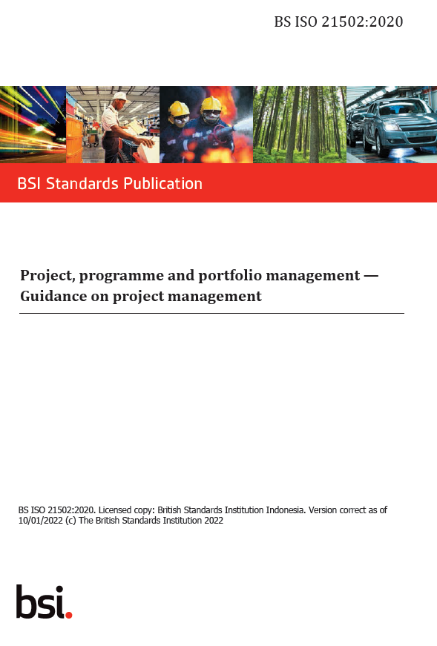
Delivery Phase of Asset – Digital Twin + Project Management

Slide 17
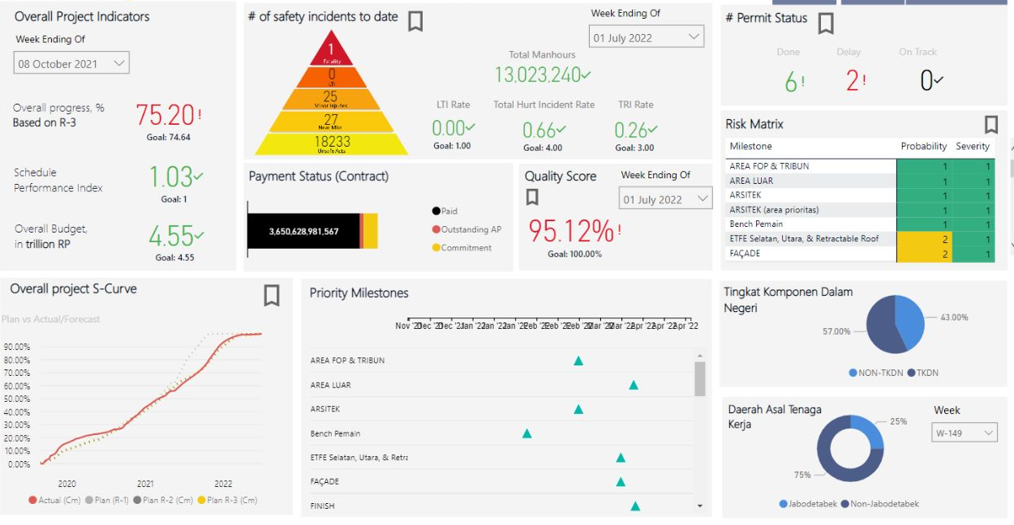
Delivery Phase of Asset – Digital (Twin) Asset + Project Management

Slide 18
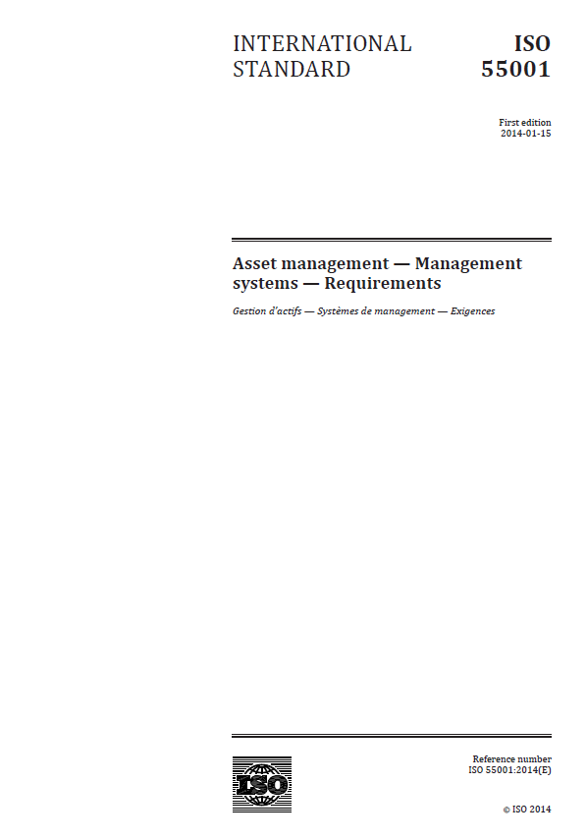
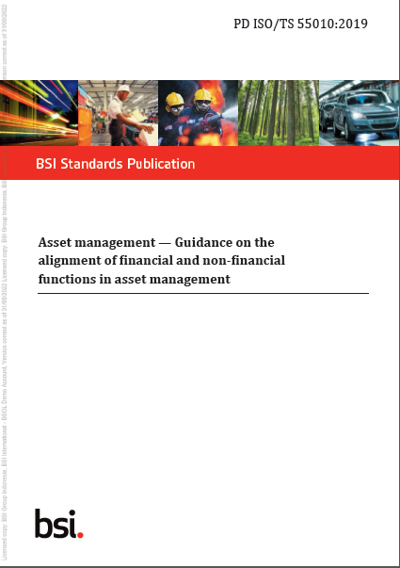
Operational Phase - Physical Asset vs Digital (twin) Asset
Digital Asset
Physical Asset + Digital Asset

Slide 19
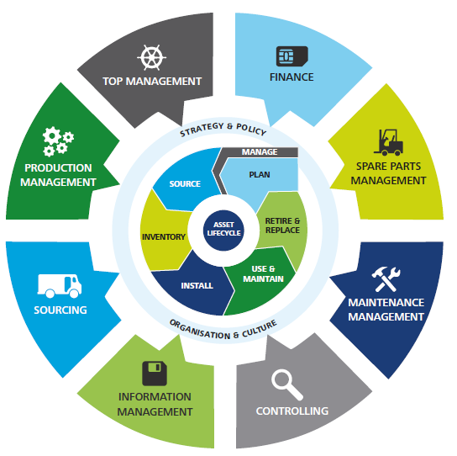
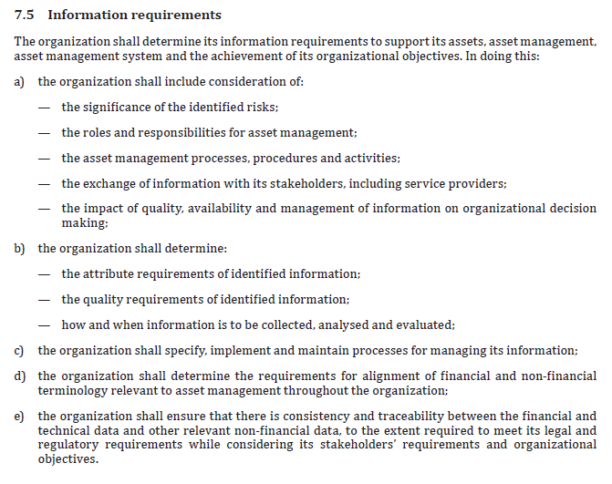
EAM – Enterprise Asset Management
Sistem manajemen yang melibatkan sebuah pengelolaan dan juga pemeliharaan asset fisik suatu organisasi di sepanjang siklus hidup asset yang dimiliki.

Slide 20
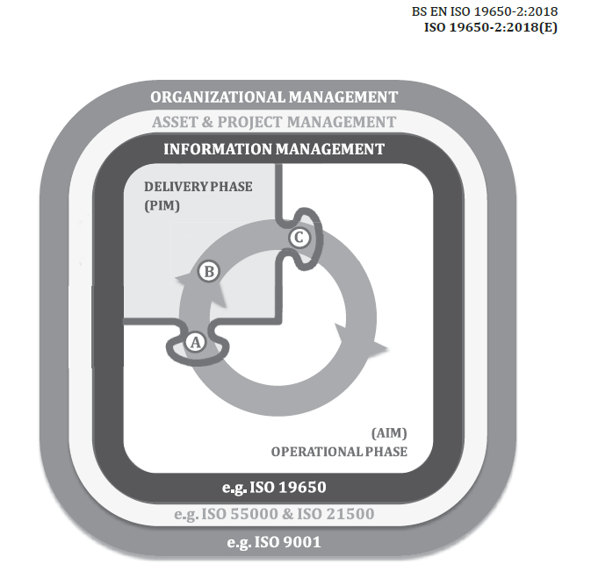
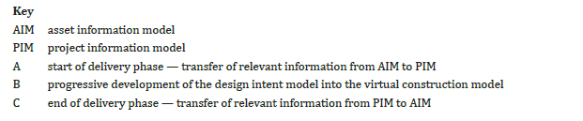
Elaboration

Slide 21
1. BIM – as a Sustainability Way

Slide 22

BIM and Sustainable Development
Notes:
BIM can have a significant role in improving the process and products in the built environment.
The 17 sustainable development goals (SDGs) to transform our world:
Goal 1: No poverty
Goal 2: Zero hunger
Goal 3: Good health and well-being
Goal 4: Quality education
Goal 5: Gender equality
Goal 6: Clean water and sanitation
Goal 7: Affordable and clean energy
Goal 8: Decent work and economic growth
Goal 9: Industry, innovation and infrastructure
Goal 10: Reduced inequality
Goal 11: Sustainable cities and communities
Goal 12: Responsible consumption and production
Goal 13: Climate action
Goal 14: Life below water
Goal 15: Life on land
Goal 16: Peace and justice strong institutions
Goal 17: Partnerships to achieve the goal

Slide 23

Construction ambitions
Lower costs
33%
Reduksi cost awal Konstruksi dan life cycle cost dari suatu asset
Faster delivery
50%
Reduksi total waktu keseluruhan, inception hingga completion ; Untuk aset baru maupun diperbaharui
Lower
emissions
50%
Reduksi Carbon emissions
Notes:
The vision of where the construction industry will be in 2025 is necessary.
UK: The ambitions of the report outlined the need to ensure that we were spending less, building faster, reducing greenhouse gas emissions and improving our exports by the figures outlined above. The ambitions were strong and the necessary requirement to be put in place would need to radically change the way we work.
People: An industry that is known for its talented and diverse workforce:
This would include the need to re-invigorate the image of the industry and inspire young people. We also need to focus our needs on the skills and capabilities of our existing workforce and ensure we retain, encourage and train workers to meet the demands for the future.
Smart: An industry that is efficient and technologically advanced:
The need to invest in smart construction and digital design is of paramount importance. The radical changes that exist in the rise of the digital economy will have implications for UK construction and this must be addressed. The suggestion is to bring forward more research and innovation and invest in technology. BIM is also included to ensure we are able to deliver more sustainable buildings, more quickly and efficiently and promote wider offsite manufacturing.
Sustainable: An industry that leads the world in low carbon and green construction exports:
The need to improve the energy performance of existing assets and new ones is important. The global growth of green and sustainable building construction is increasing and we must be ready to ensure we can deliver on this. We must also ensure our client capability increases and procurement challenges are addressed as the way projects come to market has a significant impact on the ability to be able to innovate and provide valuable solutions.
Example: the pilot project for the UK BIM Mandate was Ministry of Justice – Cookham Wood YOI (Youth Offenders Institution):
Cost reduced from £2910/m2 to £2332/m2 (-19%)
Programme reduced from 50 weeks to 44 weeks (-12%)

Slide 24
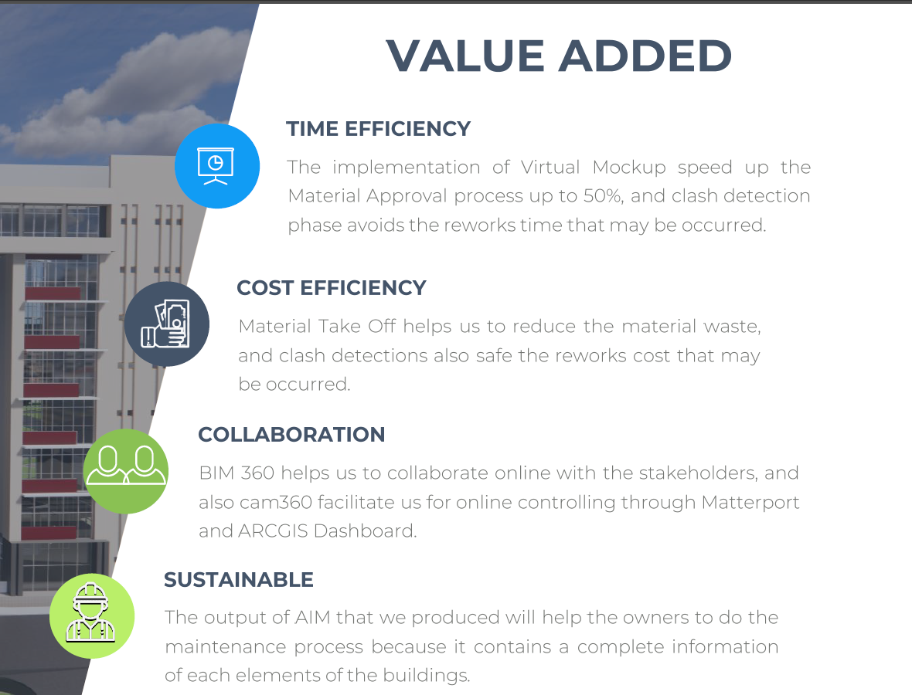
BIM Adoption Circle

Slide 25
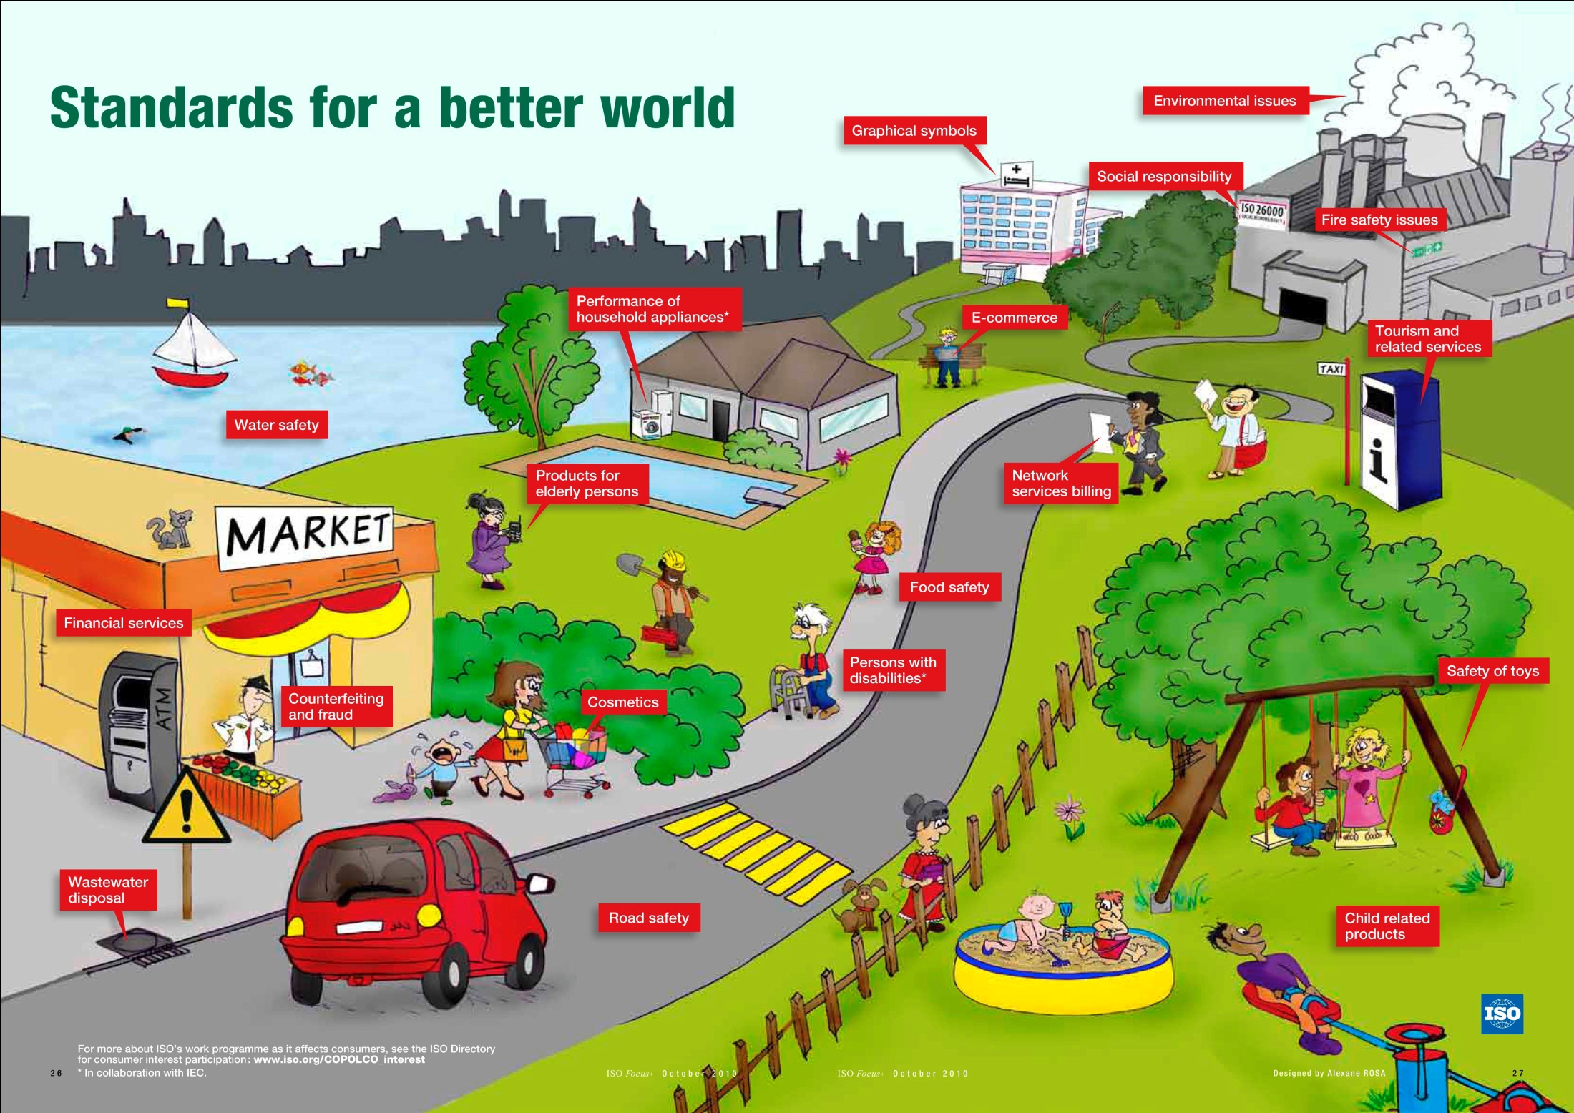
The Impact of Standards
BIM
Smart City

Slide 26
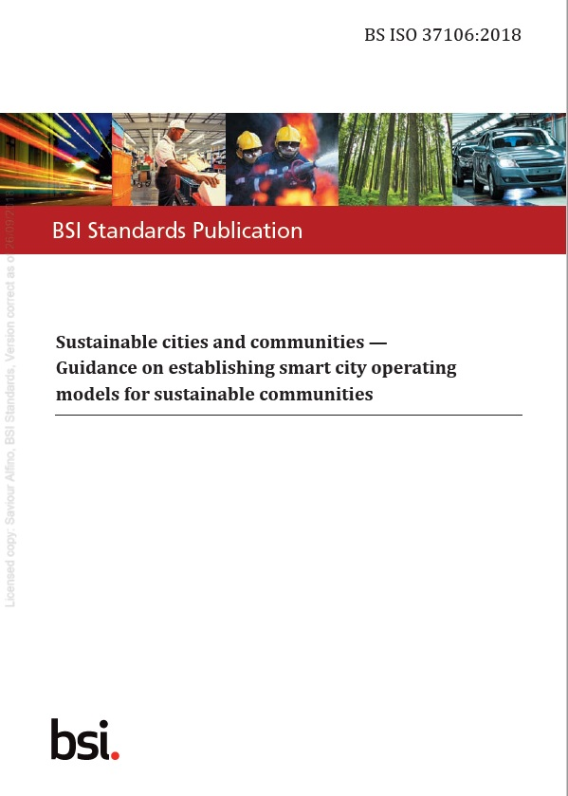

The need for Smart Cities & Communities
ISO 37106:2018 Standard
ISO 37106 outlines 4 key areas :
DELIVERY PRINCIPLES
KEY CROSS-CITY DELIVERY PROCESSES
BENEFIT REALIZATION STRATEGY
RISK MANAGEMENT
Copyright © 2018 BSI. All rights reserved
26

Slide 27

How can we create Smarter places to live in
IKN – IbuKotaNusantara
Thanks
Copyright © 2020 BSI. All rights reserved

